Slide 1

THEOLOGICAL
DIALOGUES
of the Evangelical Lutheran Church of Finland
From doctrinal encounter to visible communion, common witness and practical cooperation
Tomi Karttunen | 2026
Notes:
[Sources]
Karttunen, Tomi. Grace Opens Communion: Theological Dialogues and Practical Ecumenism of the Evangelical Lutheran Church of Finland (2020).
Evangelical Lutheran Church of Finland, “Theological Dialogues”, https://evl.fi/plus/seurakuntaelama/kansainvalisyys/ekumenia/oppikeskustelut/ (accessed 2 September 2026).
Visual on this slide was generated with Microsoft Copilot.
[/Sources]

Slide 2
Purpose, mandate and ecumenical horizon
A church-to-church process rooted in faith, worship and mission
Mandate
Theological task
Goal
Delegates are authorized by the church. Dialogues serve the whole church, while agreements require the highest level of ecclesial decision-making.
Clarify Lutheran confession in conversation with Scripture, the ancient Church and the lived reality of partner churches.
Sufficient doctrinal agreement for deeper communion: worship, sacraments, ministry, witness and service.
Visible unity is not uniformity. It is communion in reconciled diversity.
Notes:
[Sources]
Karttunen, Tomi. Grace Opens Communion: Theological Dialogues and Practical Ecumenism of the Evangelical Lutheran Church of Finland (2020).
Evangelical Lutheran Church of Finland, “Theological Dialogues”, https://evl.fi/plus/seurakuntaelama/kansainvalisyys/ekumenia/oppikeskustelut/ (accessed 2 September 2026).
[/Sources]

Slide 3

A century-long trajectory
Key milestones in Finland’s bilateral and multilateral engagement
1933–36
Church of England
restricted communion
1970
Russian Orthodox Church
systematic bilateral dialogue
1983–89
Free Church and Pentecostals
domestic minority churches
1989
Orthodox Church of Finland
national Lutheran–Orthodox dialogue
1992–96
Porvoo process
communion with Anglican churches
1997–2017
Baptists, Methodists, Catholics
new dialogues and agreements
Notes:
[Sources]
Karttunen, Tomi. Grace Opens Communion: Theological Dialogues and Practical Ecumenism of the Evangelical Lutheran Church of Finland (2020).
Evangelical Lutheran Church of Finland, “Theological Dialogues”, https://evl.fi/plus/seurakuntaelama/kansainvalisyys/ekumenia/oppikeskustelut/ (accessed 2 September 2026).
Visual on this slide was generated with Microsoft Copilot.
[/Sources]

Slide 4
The dialogue landscape
Different relationships, one coherent ecumenical vocation
Orthodox
Western catholic
Free-church
Methodist & Protestant
Russian Orthodox Church
Orthodox Church of Finland
Church of England / Porvoo
Catholic Church in Finland
Free Church
Pentecostals
Baptists
Adventists
Methodist churches
EKD and Protestant Europe
Shared grammar: Trinity • Christ • Scripture • apostolic faith • baptism • Eucharist • ministry • mission
Notes:
[Sources]
Karttunen, Tomi. Grace Opens Communion: Theological Dialogues and Practical Ecumenism of the Evangelical Lutheran Church of Finland (2020).
Evangelical Lutheran Church of Finland, “Theological Dialogues”, https://evl.fi/plus/seurakuntaelama/kansainvalisyys/ekumenia/oppikeskustelut/ (accessed 2 September 2026).
[/Sources]

Slide 5

Orthodox dialogues
From justification and theosis to sacramental communion and public witness
Russian Orthodox Church
Orthodox Church of Finland
Dialogue 1970-2022
Christ present in faith
Justification and theosis
Faith and love
Dialogue since 1989
Nicaean faith
Liturgy and sacraments
Ministry and succession
Mutual recognition of baptism 2022
Distinctive Finnish contribution
Ecumenical Luther research connected justification with participation in Christ. The dialogues also linked doctrine with social ethics, creation, anthropology and common witness.
Notes:
[Sources]
Karttunen, Tomi. Grace Opens Communion: Theological Dialogues and Practical Ecumenism of the Evangelical Lutheran Church of Finland (2020).
Evangelical Lutheran Church of Finland, “Theological Dialogues”, https://evl.fi/plus/seurakuntaelama/kansainvalisyys/ekumenia/oppikeskustelut/ (accessed 2 September 2026).
Visual on this slide was generated with Microsoft Copilot.
[/Sources]

Slide 6
Anglican–Lutheran convergence
From the 1936 relationship to the Porvoo Communion
1933–34
1936
1989–92
1996
Official conversations
Ecclesial relationship
Porvoo dialogue
Porvoo Declaration
Porvoo’s breakthrough
The historic episcopate was interpreted within the apostolicity of the whole Church. The result was close communion, recognition of sacraments and ordained ministries.
Notes:
[Sources]
Karttunen, Tomi. Grace Opens Communion: Theological Dialogues and Practical Ecumenism of the Evangelical Lutheran Church of Finland (2020).
Evangelical Lutheran Church of Finland, “Theological Dialogues”, https://evl.fi/plus/seurakuntaelama/kansainvalisyys/ekumenia/oppikeskustelut/ (accessed 2 September 2026).
[/Sources]

Slide 7
Lutheran–Catholic dialogue in Finland
Justification becomes ecclesial: Church, Eucharist and ministry
2002–2010
2013–2017
Open questions
Justification in the Life of the Church
The common understanding of justification was explored in relation to ecclesiology, sacraments and ministry.
Communion in Growth
A differentiated consensus on the Church, Eucharist and ordained ministry.
The universal ministry of the Bishop of Rome
Women’s ordination
Reception and authoritative evaluation
Method: state the shared fundamental truths first, then interpret legitimate confessional emphases and identify remaining differences.
Notes:
[Sources]
Karttunen, Tomi. Grace Opens Communion: Theological Dialogues and Practical Ecumenism of the Evangelical Lutheran Church of Finland (2020).
Evangelical Lutheran Church of Finland, “Theological Dialogues”, https://evl.fi/plus/seurakuntaelama/kansainvalisyys/ekumenia/oppikeskustelut/ (accessed 2 September 2026).
[/Sources]

Slide 8
Dialogues with Free Churches and Pentecostals
Trust-building, doctrinal clarification and healing of memories
1983–84 continuing
Free Church
grace, faith, baptism, church and ministry
1987–89 continuing
Pentecostals
Scripture, faith, baptism, Spirit and charisms
since 1997
Baptists
Scripture and tradition, discipleship, baptism and Eucharist
Recurring outcome: stronger mutual recognition, truthful speech about one another and a durable structure for continuing consultation.
Notes:
[Sources]
Karttunen, Tomi. Grace Opens Communion: Theological Dialogues and Practical Ecumenism of the Evangelical Lutheran Church of Finland (2020).
Evangelical Lutheran Church of Finland, “Theological Dialogues”, https://evl.fi/plus/seurakuntaelama/kansainvalisyys/ekumenia/oppikeskustelut/ (accessed 2 September 2026).
[/Sources]

Slide 9
The Methodist agreement
A dialogue that led to altar and pulpit fellowship
2002
2007
2010
Result
Dialogue begins
Partakers in Christ
Agreement approved
Fellowship & ministry
Theological basis
Shared apostolic faith; baptism and Eucharist; Church as communion; common and ordained ministry; episcopal oversight. The agreement includes recognition of sacraments and ordained ministries.
Notes:
[Sources]
Karttunen, Tomi. Grace Opens Communion: Theological Dialogues and Practical Ecumenism of the Evangelical Lutheran Church of Finland (2020).
Evangelical Lutheran Church of Finland, “Theological Dialogues”, https://evl.fi/plus/seurakuntaelama/kansainvalisyys/ekumenia/oppikeskustelut/ (accessed 2 September 2026).
[/Sources]

Slide 10
Reformed and Protestant relations
Ecumenical openness with a consistent Lutheran theological criterion
Leuenberg Concord
Active participation
Bilateral solution
Finland did not sign in 1977. Concerns focused on method, the meaning of church fellowship, confessional continuity and the Eucharistic formulation.
The ELCF has nevertheless contributes to theological work in the Communion of Protestant Churches in Europe as an observer and participating church.
The 2002 agreement with the Evangelical Church in Germany articulated a theological basis compatible with Finnish Lutheran commitments and enabled pulpit and altar fellowship. An earlier agreement 1977. Agreement on intercommunion with the Church of Scotland 1954.
Notes:
[Sources]
Karttunen, Tomi. Grace Opens Communion: Theological Dialogues and Practical Ecumenism of the Evangelical Lutheran Church of Finland (2020).
Evangelical Lutheran Church of Finland, “Theological Dialogues”, https://evl.fi/plus/seurakuntaelama/kansainvalisyys/ekumenia/oppikeskustelut/ (accessed 2 September 2026).
[/Sources]

Slide 11
A characteristic Finnish ecumenical method
Doctrinal seriousness and receptive learning belong together. Communion can grow gradually step by step.
1
2
3
4
Begin with common Christian faith
State fundamental truths
Interpret differences (sacraments, ministry)
Receive and decide
Start from the shared apostolic faith.
Identify consensus in the substance of faith.
Ask whether emphases are legitimate or church-dividing.
Translate dialogue into ecclesial reception and practice.
Notes:
[Sources]
Karttunen, Tomi. Grace Opens Communion: Theological Dialogues and Practical Ecumenism of the Evangelical Lutheran Church of Finland (2020).
Evangelical Lutheran Church of Finland, “Theological Dialogues”, https://evl.fi/plus/seurakuntaelama/kansainvalisyys/ekumenia/oppikeskustelut/ (accessed 2 September 2026).
[/Sources]

Slide 12
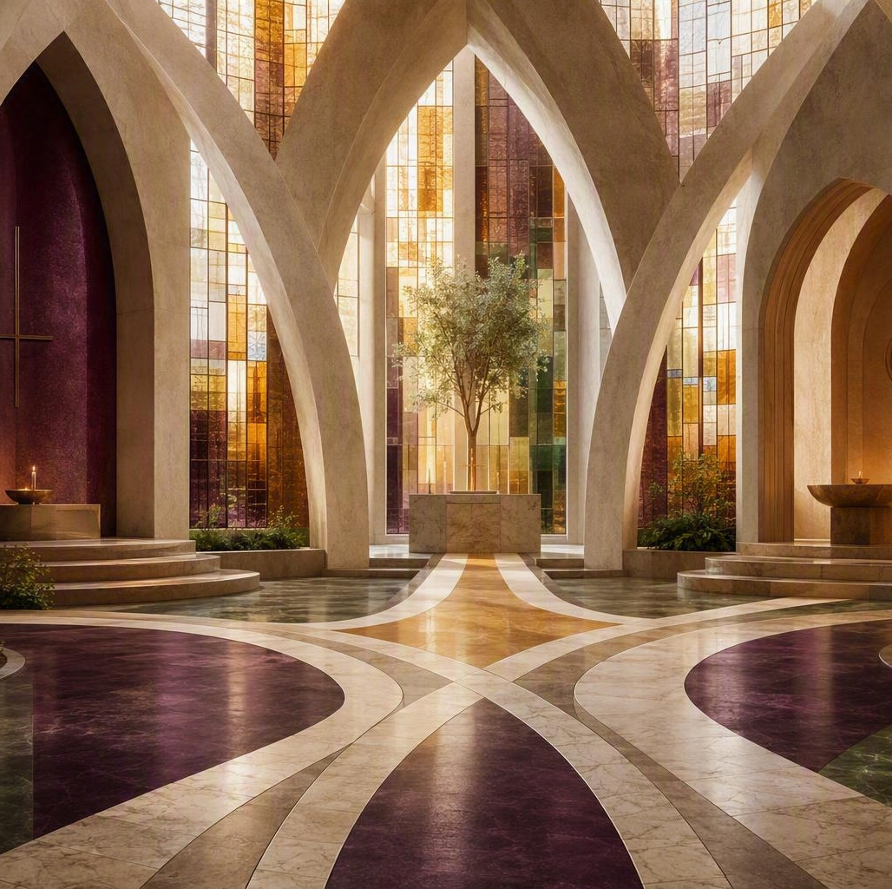
From dialogue to practical ecumenism
Theological convergence changes how churches pray, serve and cooperate
Worship
Common prayer, preaching hospitality and Eucharistic communion where agreed.
Witness
Joint proclamation, Christian education and public theology.
Service
Diaconal projects, migration work, crisis support and shared resources.
Structures
Consultative councils, local working groups and regular leadership contacts.
Notes:
[Sources]
Karttunen, Tomi. Grace Opens Communion: Theological Dialogues and Practical Ecumenism of the Evangelical Lutheran Church of Finland (2020).
Evangelical Lutheran Church of Finland, “Theological Dialogues”, https://evl.fi/plus/seurakuntaelama/kansainvalisyys/ekumenia/oppikeskustelut/ (accessed 2 September 2026).
Visual on this slide was generated with Microsoft Copilot.
[/Sources]

Slide 13
What the dialogues have achieved
Not every dialogue produces an agreement, but every sustained relationship can bear ecclesial fruit
Relationship | Principal fruit | Current horizon
Orthodox | shared theological language, practical cooperation | visible unity and sacramental communion
Anglican / Porvoo | close communion, cooperation and consultation | mission and ministry together
Methodist | altar and pulpit fellowship, cooperation and consultation | deeper ecclesial communion
Catholic | differentiated consensus (justification, preliminary differentiated consensus on Church, Eucharist, and Ministry) | authoritative reception and next declaration
Free-church partners | trust and continuing consultation, practical cooperation | baptism, Eucharist and common witness
Protestant Europe | cooperation without CPCE membership | coherent Lutheran–Protestant convergence
Notes:
[Sources]
Karttunen, Tomi. Grace Opens Communion: Theological Dialogues and Practical Ecumenism of the Evangelical Lutheran Church of Finland (2020).
Evangelical Lutheran Church of Finland, “Theological Dialogues”, https://evl.fi/plus/seurakuntaelama/kansainvalisyys/ekumenia/oppikeskustelut/ (accessed 2 September 2026).
[/Sources]

Slide 14
Grace opens communion
A Finnish synthesis
Confessional identity can motivate rather than obstruct ecumenism.
Doctrinal dialogue, spiritual ecumenism and practical cooperation must reinforce one another.
The horizon remains visible unity in apostolic faith, sacramental life, ministry, witness and service.
“That they may all be one … so that the world may believe.” John 17:21
Notes:
[Sources]
Karttunen, Tomi. Grace Opens Communion: Theological Dialogues and Practical Ecumenism of the Evangelical Lutheran Church of Finland (2020).
Evangelical Lutheran Church of Finland, “Theological Dialogues”, https://evl.fi/plus/seurakuntaelama/kansainvalisyys/ekumenia/oppikeskustelut/ (accessed 2 September 2026).
[/Sources]

